Slide 1
Big Data Based Security Analytics for Protecting Virtualized Infrastructures in Cloud Computing
By: Jordan Donovan

Slide 2
Motivation
Virtualized Infrastructures widespread deployment in cloud computing
Pool different computing resources
On-demand resource scaling
Virtualized Infrastructures are an attractive target for cyber attacks
Various forms of attacks
Limits to protecting virtualized infrastructure
Malware detection
Security analytics
Notes:
Virtualized Infrastructures widespread deployment in cloud computing
Definition: A hypervisor sustains, regulates, and manages the software-defined multi-instance architecture involved with virtualized infrastructures
Pool different computing resources
On-demand resource scaling
Virtualized Infrastructures are an attractive target for cyber attacks
Various forms of attacks
(i.e. VENOM - allows attacker to break out of guest VM and attack hypervisor)
(i.e. Heartbleed and Shellshock for variety of attacks)
Limits to protecting virtualized infrastructure
Malware detection (signature-based)
Monitoring hooks within software
Database of attack signatures
Vulnerable to zero-day attacks
Security analytics (anomaly-based)
Applies analytics to logs to determine attack presence
Big data analytics will be able to detect attacks not detected with signature-based detection techniques
Often not real-time and intrinsically non-scalable

Slide 3
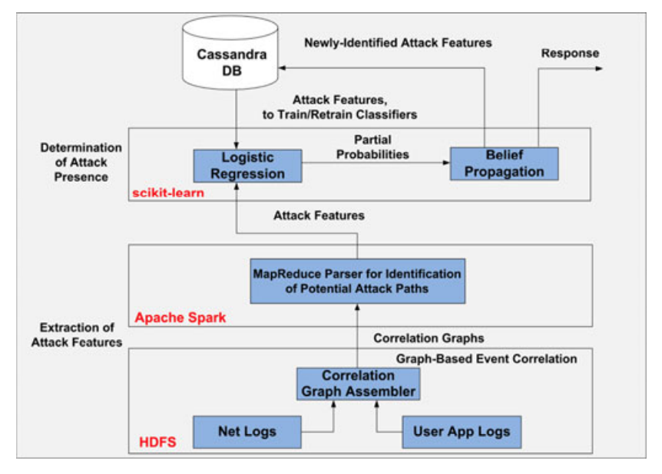
Contribution
Existing methods
Malware detection
Security analytics
Big data security analytics approach to protect virtualized infrastructures
Extract attack features
Determines attack presence
Notes:
Image is a conceptualized model of the proposed big-data (based) security analytics (BDSA) approach
Existing methods
Malware detection
In-VM and outside-VM Interworking approach to malware detection
in-VM agent running in virtual environment and scrutiny server monitoring behavior
Hypervisor assisted malware detection
Uses underlying hypervisor for malware detection
Security analytics
Clustering
Organizes data into groups based on feature similarities
Graph-based
Improves upon clustering by establishing accurate correlations between events
Attacks can not be detected in real-time
Big data security analytics approach to protect virtualized infrastructures
Main idea: detect in real-time any rootkit or malware attacks vial a holistic and efficient use of all information obtained from the virtualized infrastructure.

Slide 4
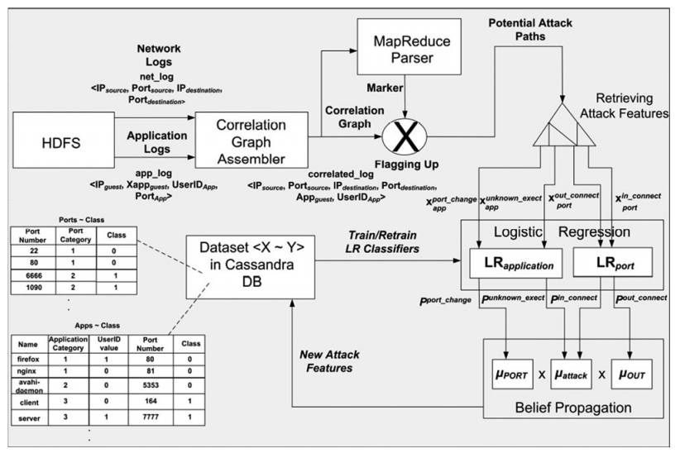
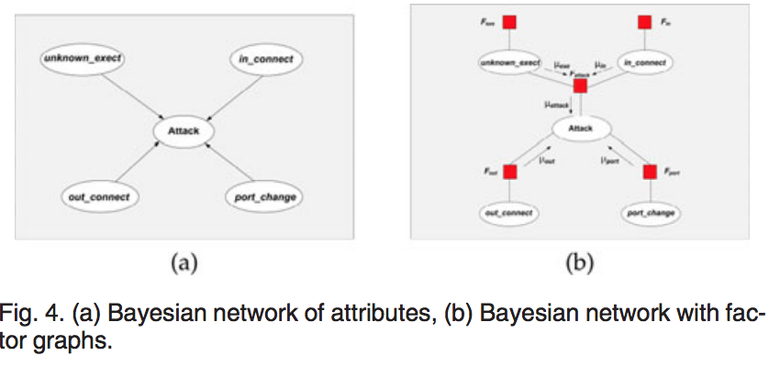
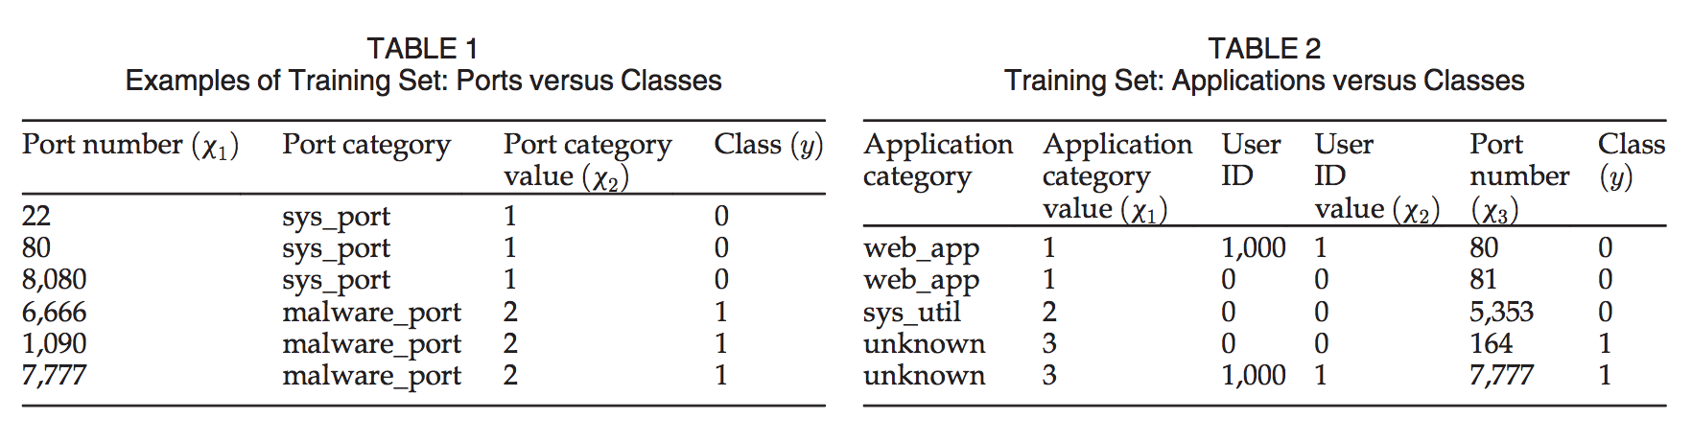
Proposal
Extract attack features
Graph-based event correlation
Map-reduce parser based detection for potential attacks
Determine attack presence
Training and retraining logistic regression
Attack classification using belief propagation
Notes:
Top right is a look at the architecture proposed
Extract attack features
Graph-based event correlation
Collection of log entries are used to form a correlation graph based on these two observations
Compromised VMs tend to communicate more with other guest VMs
The communication of the malware is through the execution of malware on the VM and listening for external sources
map-reduce parser based detection of potential attacks
Parses the correlation graph for potential attack paths
The map process involves sorting key-value pairs from correlation graph
The key-value pairs form the map process are unified and counted, then flagged as potential attack paths
Determines attack presence
Two-step machine learning
Training and retraining of logistic regression
Logistic regression is used in binary classification, it provides a quick means of training a classifier to determine test data projection to one of the two categories
Four attributes for potential attack: (in_connect, out_connect, unknown_exec, and port_change)
Source and Destination port number (in_connect and out_connect) are used to determine attack presence
Application in guest VM (unknown_exec, port_change)
Outputs respective conditional probabilities of each feature belonging to each of the two pre-defined classes
Attack classification using belief propagation
With each attribute (in_connect, out_connect, unknown_exec, and port_change) represented as a node, they form a Bayesian network as shown in bottom right.
Uses conditional probabilities to construct conditional probability table
Factor graphs are used since they are easier to update
Uses Bayesian network with factor graphs and message-passing to determine the belief in attack presence
If an attack is found, the features are added to the Cassandra DB

Slide 5
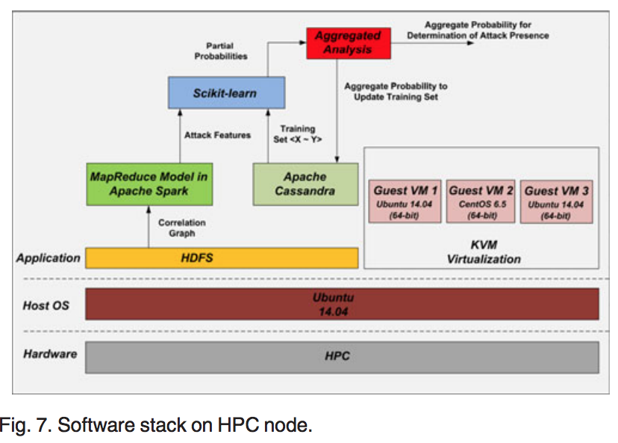
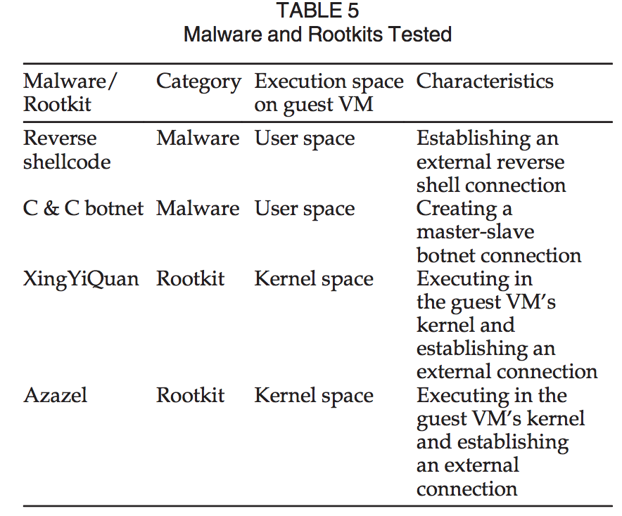
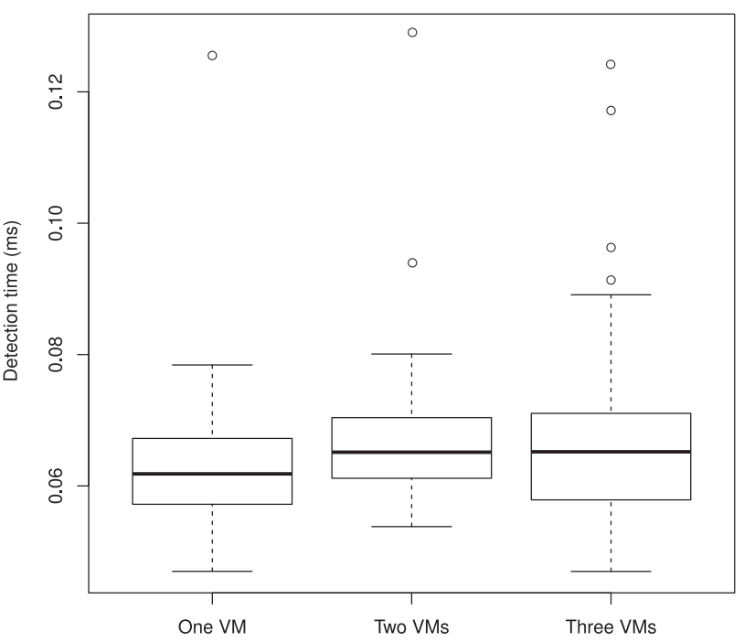
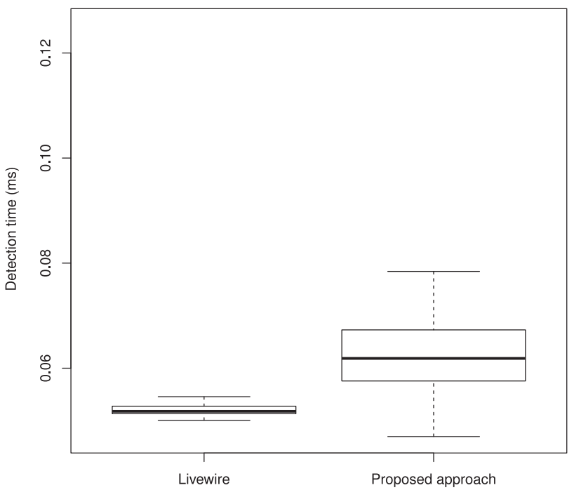
Results
Testbed
Detection of userspace malware and kernel-level rootkits
Measurement of the average detection time
Comparisons with existing security approach
Notes:
Testbed
HPC server nodes with Ubuntu 14.04, Each node has Intel Xeon quadcore Processor 2.66Ghz, 12Gbs memory
Virtualization environment is set up
using Kernel-based Virtual Machine (KVM),
Apache Hadoop installed for distributed log storage,
Apache Spark for real-time data collection and map-reduce parsing
Cassandra DB distributed storage of identified malicious applications and ports and real-time training / retraining of logistic regression classifiers
Scikit learn python is installed for logistic regression classifier creation
Belief of attack threshold must be below 0.2 in this experiment
Guest VM CentOS 6.5 and two running Ubuntu 14.04 on one of the HPC server nodes
Detection of userspace malware and kernel-level rootkits
Userspace malware (application-level malware)
Reverse Shellcode each is set up in one VM and attacks another VM
C & C botnet
Executed 5 times with up to three guest VMs, BDSA approach is able to detect all of them
Kernel Level Rootkits
XinYiQuan each is set up – one VM is infected and attacks other VM(s)
Azazel
Exectured 5 times with up to 3 guest VMs, BDSA is successful in detection of all of them
Measurment of the average detection time
Tests are ran on 1, 2, and 3 guest VMs with each of the malware / rootkits
Tests are repeated 10 times consecutively for 5 rounds, each test and round have a wait period between them (2 min)
Averages are taken from each of the 5 rounds
Slight increase in time from 1 to 2 VMs (due to running different OS’s) back down some on 3 VMs
The outliers on the graph are due to the ssh server automatically resetting itself to prevent against DDOS attacks
Comparisons with existing security approach
Compared to Livewire, similarity in external monitoring of guest VM approach
At first glance, livewire appears faster by .04 ms by using principle of locality
BDSA approach proposed has to use ssh communication whereas livewire runs on same host
Also the BDSA approach proposed detection time includes the HPC headnode of distributing the map-reduce processing across HPC nodes
In the best case the proposed BDSA approach does better by .02 ms,
Scalability, with BDSA overall detection times are consistent with increased VMs whereas livewire has to be deployed to each VM
Is competitive with Livewire approach

Slide 6
